Slide 1

Chapter 2
The Entrepreneurial Mind: Crafting a Personal Entrepreneurial Strategy

Slide 2

Achieving Entrepreneurial Greatness
Three core principles of Marion Labs and the
Kauffman Foundation:
Treat others as you would want to be treated.
Share the wealth that is created with all those who have contributed to it at all levels.
Give back to the community.
© McGraw-Hill Australia Pty Ltd 2011
PowerPoint slides for New Venture Creation: Entrepreneurship for the 21st Century (A Pacific Rim Focus) by Timmons et al.
2-2

Slide 3
The Six Core Principles of Richard Pratt and the VISY Corporation:
Philanthropy is good for business.
Take philanthropy to the factory floor.
Link it to your client base.
Cast the charity net wide.
Manage charity work on a professional basis.
Decide charity priorities in advance.
© McGraw-Hill Australia Pty Ltd 2011
PowerPoint slides for New Venture Creation: Entrepreneurship for the 21st Century (A Pacific Rim Focus) by Timmons et al.
2-3

Slide 4
Leadership and Human Behaviour
A single psychological model of entrepreneurship has not been supported by research.
But behavioural scientists, venture capitalists, investors, and entrepreneurs agree the venture will depend a great deal upon the talent and behavior of the lead entrepreneur and his or her team.
Myths still exist about entrepreneurs and entrepreneurship.
© McGraw-Hill Australia Pty Ltd 2011
PowerPoint slides for New Venture Creation: Entrepreneurship for the 21st Century (A Pacific Rim Focus) by Timmons et al.
2-4

Slide 5
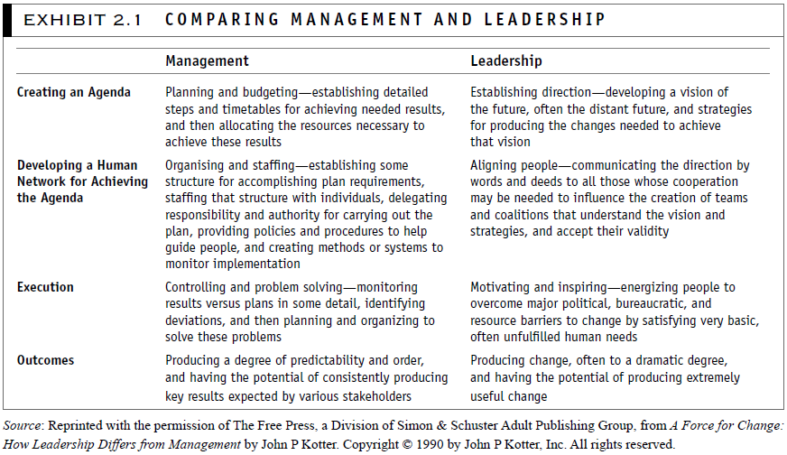
© McGraw-Hill Australia Pty Ltd 2011
PowerPoint slides for New Venture Creation: Entrepreneurship for the 21st Century (A Pacific Rim Focus) by Timmons et al.
2-5

Slide 6
© McGraw-Hill Australia Pty Ltd 2011
PowerPoint slides for New Venture Creation: Entrepreneurship for the 21st Century (A Pacific Rim Focus) by Timmons et al.
2-6

Slide 7
Converging on the Entrepreneurial Mind
Desirable and Acquirable Attitudes and Behaviours.
Eight Dominant Themes:
Commitment and Determination.
Courage.
Leadership.
Opportunity Obsession.
Tolerance of Risk, Ambiguity and Uncertainty.
Creativity, Self-Reliance and Adaptability.
Motivation to Excel.
Intuitive.
© McGraw-Hill Australia Pty Ltd 2011
PowerPoint slides for New Venture Creation: Entrepreneurship for the 21st Century (A Pacific Rim Focus) by Timmons et al.
2-7

Slide 8
New research: Praeger Perspective Series – draws
attention to the various components of the
entrepreneurial process.
People – entrepreneurship as a form of human action.
Process – proceeds through the life cycle of a new
venture start up.
Place – the importance of the wide and diverse range of
contextual factors that influence both the entrepreneur
and the entrepreneurship process.
© McGraw-Hill Australia Pty Ltd 2011
PowerPoint slides for New Venture Creation: Entrepreneurship for the 21st Century (A Pacific Rim Focus) by Timmons et al.
2-8

Slide 9
© McGraw-Hill Australia Pty Ltd 2011
PowerPoint slides for New Venture Creation: Entrepreneurship for the 21st Century (A Pacific Rim Focus) by Timmons et al.
2-9

Slide 10
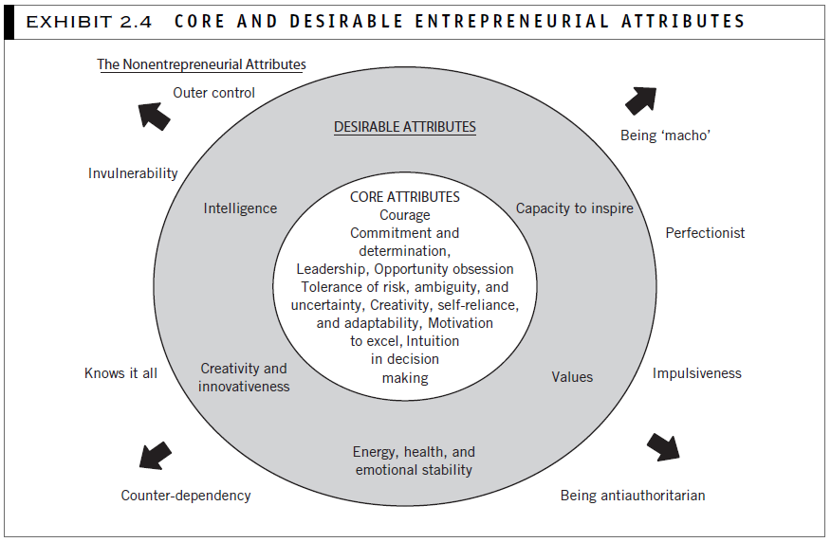
© McGraw-Hill Australia Pty Ltd 2011
PowerPoint slides for New Venture Creation: Entrepreneurship for the 21st Century (A Pacific Rim Focus) by Timmons et al.
2-10

Slide 11
Three Important Aspects of Courage
Moral strength and principles.
Being a fearless experimenter.
A lack of fear of failing at the experiment:
and most undertakings.
and a lack of fear of conflict that may arise.
© McGraw-Hill Australia Pty Ltd 2011
PowerPoint slides for New Venture Creation: Entrepreneurship for the 21st Century (A Pacific Rim Focus) by Timmons et al.
2-11

Slide 12
© McGraw-Hill Australia Pty Ltd 2011
PowerPoint slides for New Venture Creation: Entrepreneurship for the 21st Century (A Pacific Rim Focus) by Timmons et al.
2-12

Slide 13
© McGraw-Hill Australia Pty Ltd 2011
PowerPoint slides for New Venture Creation: Entrepreneurship for the 21st Century (A Pacific Rim Focus) by Timmons et al.
2-13

Slide 14
The Entrepreneur’s Decision Making Style
© McGraw-Hill Australia Pty Ltd 2011
PowerPoint slides for New Venture Creation: Entrepreneurship for the 21st Century (A Pacific Rim Focus) by Timmons et al.
2-14

Slide 15
© McGraw-Hill Australia Pty Ltd 2011
PowerPoint slides for New Venture Creation: Entrepreneurship for the 21st Century (A Pacific Rim Focus) by Timmons et al.
2-15

Slide 16
The Entrepreneurial Mind in Action
Successful entrepreneurs have a wide range of personality types:
Research has considered genetics, family, education, career experience, etc., but no psychological model of entrepreneurship has been supported.
Acquired skills are more important that specific inherent traits.
© McGraw-Hill Australia Pty Ltd 2011
PowerPoint slides for New Venture Creation: Entrepreneurship for the 21st Century (A Pacific Rim Focus) by Timmons et al.
2-16

Slide 17
© McGraw-Hill Australia Pty Ltd 2011
PowerPoint slides for New Venture Creation: Entrepreneurship for the 21st Century (A Pacific Rim Focus) by Timmons et al.
2-17

Slide 18
The Concept of Apprenticeship
Shaping and Managing an Apprenticeship.
Windows of Apprenticeship.
The Concept of Apprenticeship: Acquiring the 50 000 Chunks.
Role Models.
Myths and Realities.
What Can Be Learned?
© McGraw-Hill Australia Pty Ltd 2011
PowerPoint slides for New Venture Creation: Entrepreneurship for the 21st Century (A Pacific Rim Focus) by Timmons et al.
2-18

Slide 19
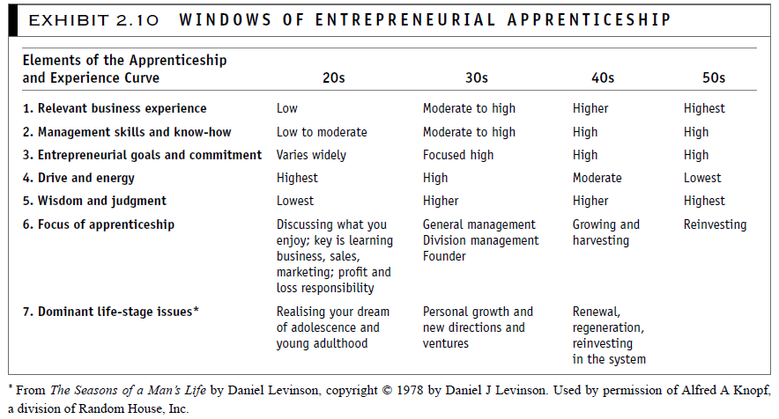
© McGraw-Hill Australia Pty Ltd 2011
PowerPoint slides for New Venture Creation: Entrepreneurship for the 21st Century (A Pacific Rim Focus) by Timmons et al.
2-19

Slide 20
© McGraw-Hill Australia Pty Ltd 2011
PowerPoint slides for New Venture Creation: Entrepreneurship for the 21st Century (A Pacific Rim Focus) by Timmons et al.
2-20

Slide 21
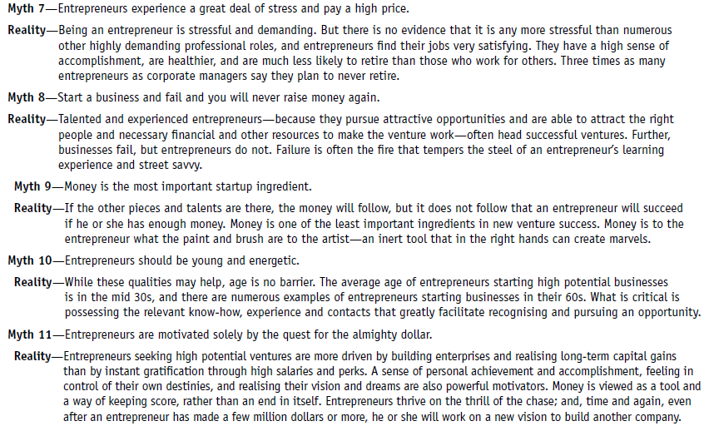
© McGraw-Hill Australia Pty Ltd 2011
PowerPoint slides for New Venture Creation: Entrepreneurship for the 21st Century (A Pacific Rim Focus) by Timmons et al.
2-21

Slide 22
© McGraw-Hill Australia Pty Ltd 2011
PowerPoint slides for New Venture Creation: Entrepreneurship for the 21st Century (A Pacific Rim Focus) by Timmons et al.
2-22

Slide 23
A Word of Caution
Leadership and achievement, the heart of the entrepreneur, are not measured by HSC, IQ tests, VCE, and others not measured include:
Leadership skills
Interpersonal skills
Team building and team playing
Creativity and ingenuity
Motivation
Learning skills (versus knowledge)
Persistence and determination
Values, ethics, honesty and
integrity
Goal-setting orientation
Self-discipline
Frugality
Resourcefulness
Resiliency and capacity to handle adversity
Ability to seek, listen, and use feedback
Reliability
Dependability
Sense of humour
© McGraw-Hill Australia Pty Ltd 2011
PowerPoint slides for New Venture Creation: Entrepreneurship for the 21st Century (A Pacific Rim Focus) by Timmons et al.
2-23

Slide 24
Exercises
The ‘Crafting a Personal Entrepreneurship Strategy’ exercise addresses the apprenticeship issue further.
The ‘Personal Entrepreneurial Strategy’ exercise is an inventory of one’s entrepreneurial abilities.
© McGraw-Hill Australia Pty Ltd 2011
PowerPoint slides for New Venture Creation: Entrepreneurship for the 21st Century (A Pacific Rim Focus) by Timmons et al.
2-24

Slide 25
Crafting a Personal Entrepreneurial Strategy
A Conceptual Scheme for Self Assessment.
Crafting an Entrepreneurial Strategy:
Profiling the Past.
Profiling the Present.
Getting Constructive Feedback.
Putting it all Together.
Thinking Ahead.
© McGraw-Hill Australia Pty Ltd 2011
PowerPoint slides for New Venture Creation: Entrepreneurship for the 21st Century (A Pacific Rim Focus) by Timmons et al.
2-25

Slide 26
© McGraw-Hill Australia Pty Ltd 2011
PowerPoint slides for New Venture Creation: Entrepreneurship for the 21st Century (A Pacific Rim Focus) by Timmons et al.
2-26

Slide 27
© McGraw-Hill Australia Pty Ltd 2011
PowerPoint slides for New Venture Creation: Entrepreneurship for the 21st Century (A Pacific Rim Focus) by Timmons et al.
2-27

Slide 28
Personal Entrepreneurial Strategy
Gather data both from yourself (past and present profiles).
Gather data from others (constructive feedback).
Evaluate the data you have.
Think ahead.
Craft your personal entrepreneurial strategy.
Estimated time to complete this important planning and goal setting exercise is 90 minutes to three hours.
© McGraw-Hill Australia Pty Ltd 2011
PowerPoint slides for New Venture Creation: Entrepreneurship for the 21st Century (A Pacific Rim Focus) by Timmons et al.
2-28

Slide 29
Reasons for Planning
Planning helps the entrepreneur with the following:
Managing the risks and uncertainties of the future.
Working smarter rather than harder.
Developing and updating a keener strategy by testing the sensibility of his or her ideas and approaches with others.
© McGraw-Hill Australia Pty Ltd 2011
PowerPoint slides for New Venture Creation: Entrepreneurship for the 21st Century (A Pacific Rim Focus) by Timmons et al.
2-29

Slide 30
Reasons for Planning
Planning helps the entrepreneur with the following:
Motivating.
Achieving ‘results orientation’.
Managing and coping with what is by nature a stressful role.
© McGraw-Hill Australia Pty Ltd 2011
PowerPoint slides for New Venture Creation: Entrepreneurship for the 21st Century (A Pacific Rim Focus) by Timmons et al.
2-30

Slide 31
Self Assessment
Generate data through observation of his or her thoughts and actions and by getting feedback from others for the purposes of the following:
Becoming aware of blind spots.
Reinforcing or changing existing perceptions of both strengths and weaknesses.
Study the data generated.
© McGraw-Hill Australia Pty Ltd 2011
PowerPoint slides for New Venture Creation: Entrepreneurship for the 21st Century (A Pacific Rim Focus) by Timmons et al.
2-31

Slide 32
Self Assessment
Develop insights.
Establish apprenticeship goals to gain any learning, experience and so forth.
Determine goals and opportunities to be seized.
© McGraw-Hill Australia Pty Ltd 2011
PowerPoint slides for New Venture Creation: Entrepreneurship for the 21st Century (A Pacific Rim Focus) by Timmons et al.
2-32

Slide 33
Constructive Feedback
Solicit feedback from those who know you well and who can be trusted.
Seek specific comments in particularly important areas and probe for detail if the feedback is unclear.
Recognise that feedback is most helpful if it is neither all positive nor all negative.
© McGraw-Hill Australia Pty Ltd 2011
PowerPoint slides for New Venture Creation: Entrepreneurship for the 21st Century (A Pacific Rim Focus) by Timmons et al.
2-33

Slide 34
Constructive Feedback
Ask for feedback in writing for contemplation and so feedback from various sources can be pulled together.
Be honest and straightforward with yourself and with others.
Avoid game playing or hidden agendas; avoid defensiveness over negative comments.
Listen carefully to what is being said and think about it; avoid answering, debating, or rationalising.
© McGraw-Hill Australia Pty Ltd 2011
PowerPoint slides for New Venture Creation: Entrepreneurship for the 21st Century (A Pacific Rim Focus) by Timmons et al.
2-34

Slide 35
Constructive Feedback
Assess whether all important information has been considered and you have been realistic in your inferences and conclusions.
Request help in identifying common threads or patterns, possible implications of self-assessment data and certain weaknesses, and other relevant information that is missing.
Seek additional feedback from others to verify feedback and to supplement data.
Reach final conclusions at a later time.
© McGraw-Hill Australia Pty Ltd 2011
PowerPoint slides for New Venture Creation: Entrepreneurship for the 21st Century (A Pacific Rim Focus) by Timmons et al.
2-35

Slide 36
Effective Goal Setting
Establishment of goals that are specific and concrete, measurable, related to time, realistic and attainable.
Establishment of priorities, including the identification of conflicts and trade-offs and how these can be resolved.
Identification of potential problems and obstacles that could prevent goals from being attained.
© McGraw-Hill Australia Pty Ltd 2011
PowerPoint slides for New Venture Creation: Entrepreneurship for the 21st Century (A Pacific Rim Focus) by Timmons et al.
2-36

Slide 37
Effective Goal Setting
Specification of action steps that are to be performed to accomplish the goal.
Indication of how results will be measured.
Establishment of milestones for reviewing progress and tying these to specific dates on the calendar.
© McGraw-Hill Australia Pty Ltd 2011
PowerPoint slides for New Venture Creation: Entrepreneurship for the 21st Century (A Pacific Rim Focus) by Timmons et al.
2-37

Slide 38
Effective Goal Setting
Identification of risk involved in meeting the goals.
Identification of help and other resources that may be needed to obtain goals.
Periodic review of progress and revision of goals.
© McGraw-Hill Australia Pty Ltd 2011
PowerPoint slides for New Venture Creation: Entrepreneurship for the 21st Century (A Pacific Rim Focus) by Timmons et al.
2-38

